Slide 1
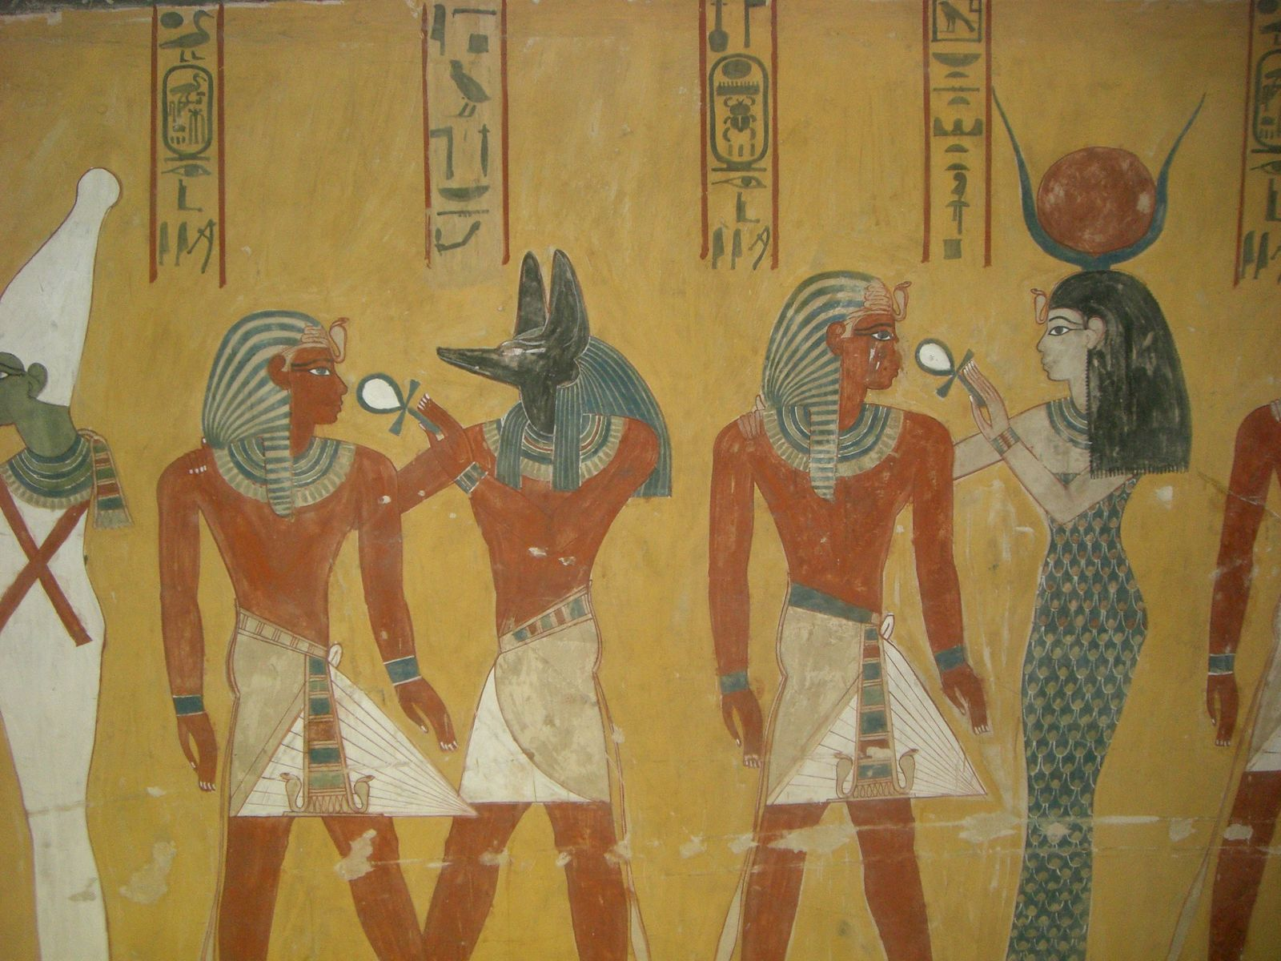
“Fake news”: A new title for an old strategy
SIDNEY SUSSEX TASTER LECTURE: ARCHAEOLOGY TRIPOS
DR. SHEILA KOHRING, DoS
23 FEBRUARY 2017

Slide 2
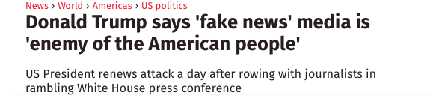
Online Guardian piece 17 December 2016
Online Times editorial piece
18 February 2017
Story originally on Newsnight 16 February
Online BBC news 17 February 2017
Independent Online headline
18th February 2017

Slide 3
Origins of language
Why do we communicate?
Is it just about information transfer?
Reconstructing past communication

Slide 4
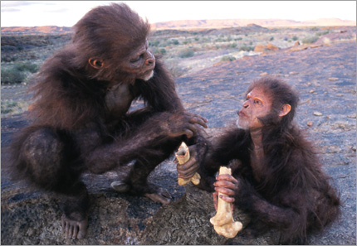
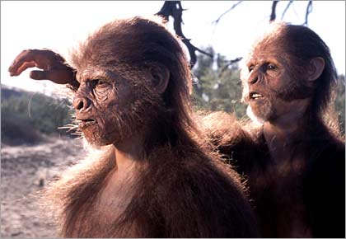
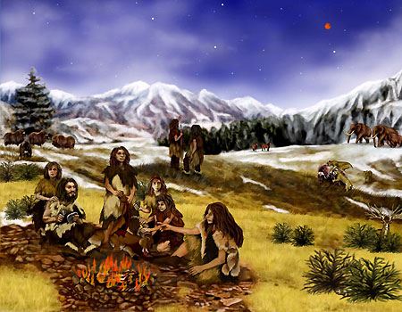
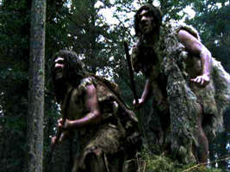
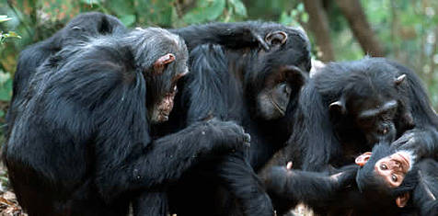
Language as social glue

Slide 5
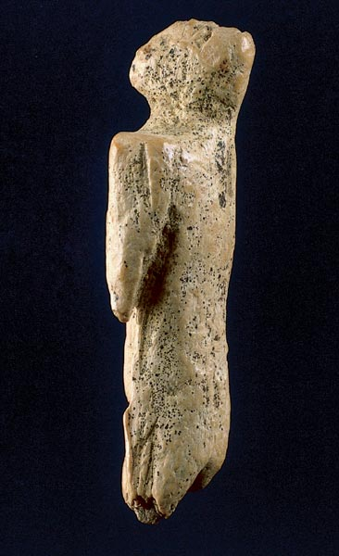
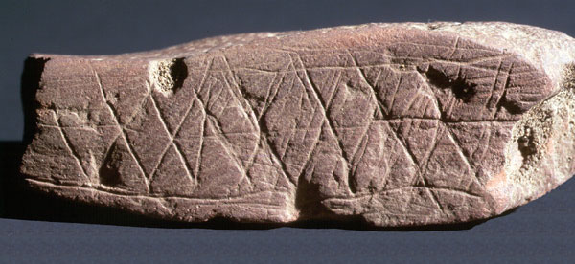
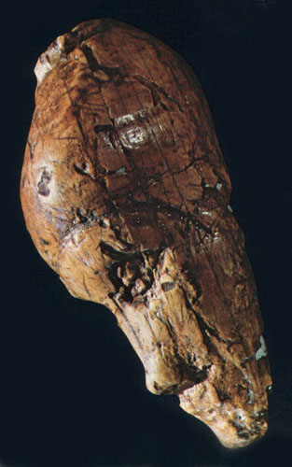
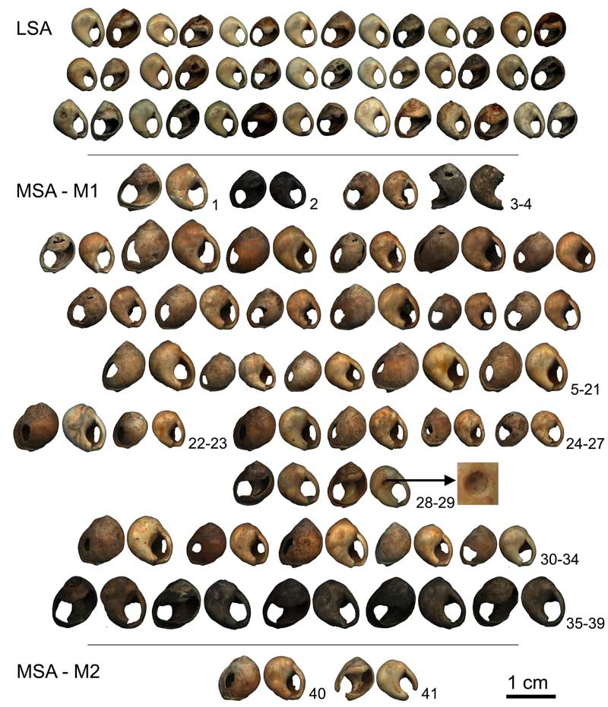
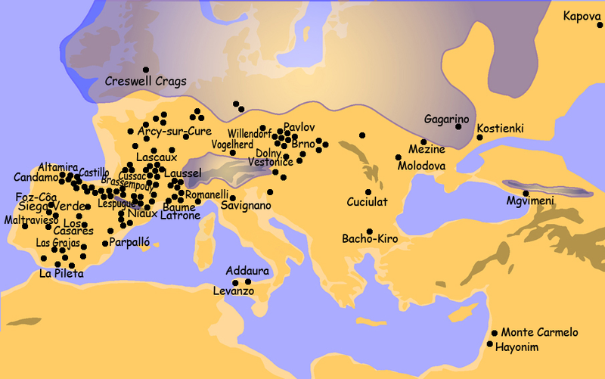
Homo sapiens and the “Symbolic Revolution”

Slide 6
Communication and archaeology
“Finding” past languages in prehistory is problematic – we have the modern distribution as primary evidence
There is no direct correlation between the language people use and the material culture people use.
BUT, material culture is a pivotal means of human communication and symbolism

Slide 7
Texts
Origins
Material culture plus?
Materiality and context contributions

Slide 8
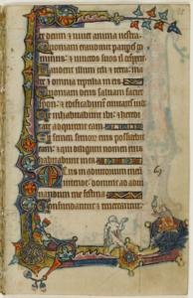
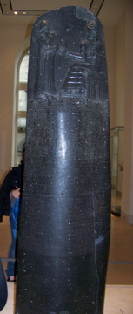
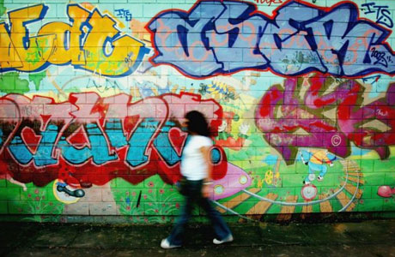
Writing:
External Symbolic Storage
Act of information transcription?
Definition of “civilisation” (V. Gordon Childe)?
Symbolism in the act of writing and the material it is written upon.

Slide 9
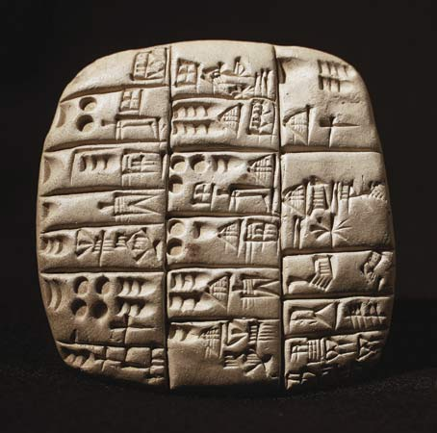
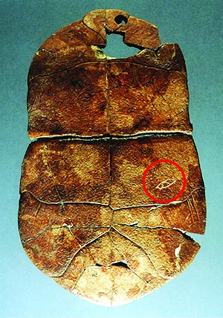
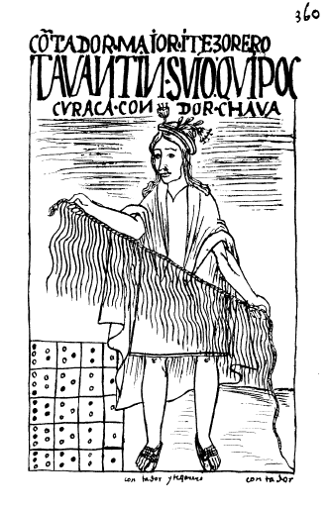
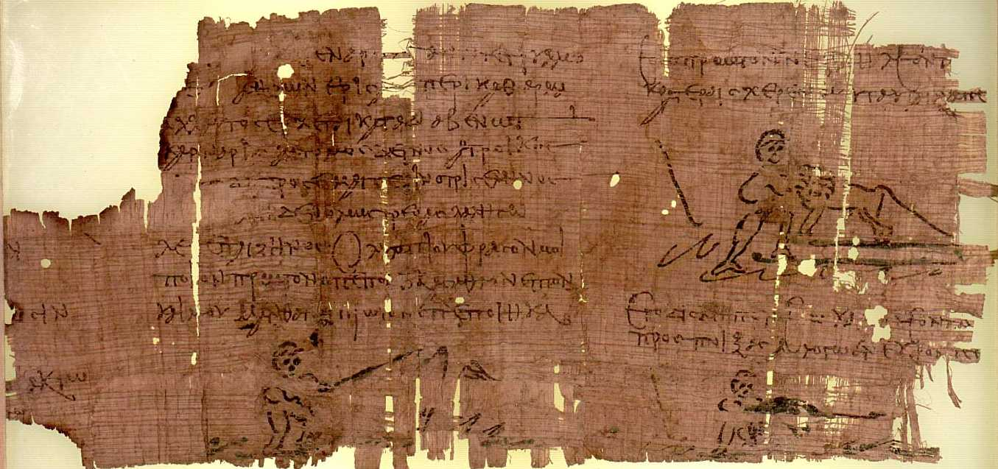
Early Writing systems
Ideographic
Pictographic
Alphabetic
Other systems
  Individual marks
  Calendrical systems
  Tokens
Mnemonic devices
  “Quipu”

Slide 10
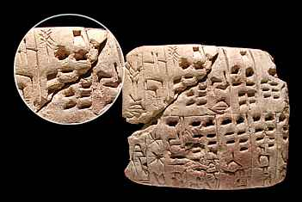
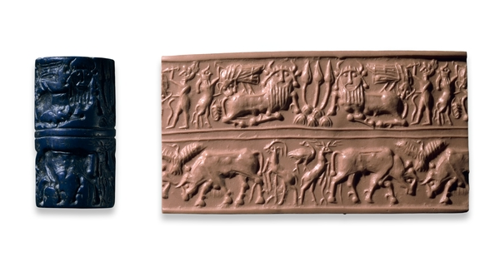
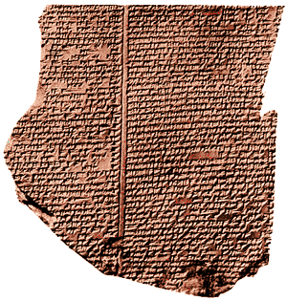
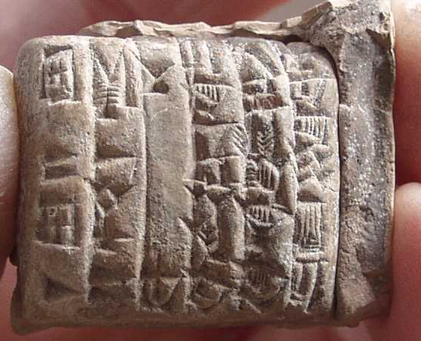
Earliest writing: Mesopotamia
Pragmatic uses
  Administrative
  Accounting
Use diversifies include social and political aspects
  Ritual
  Narratives

Slide 11
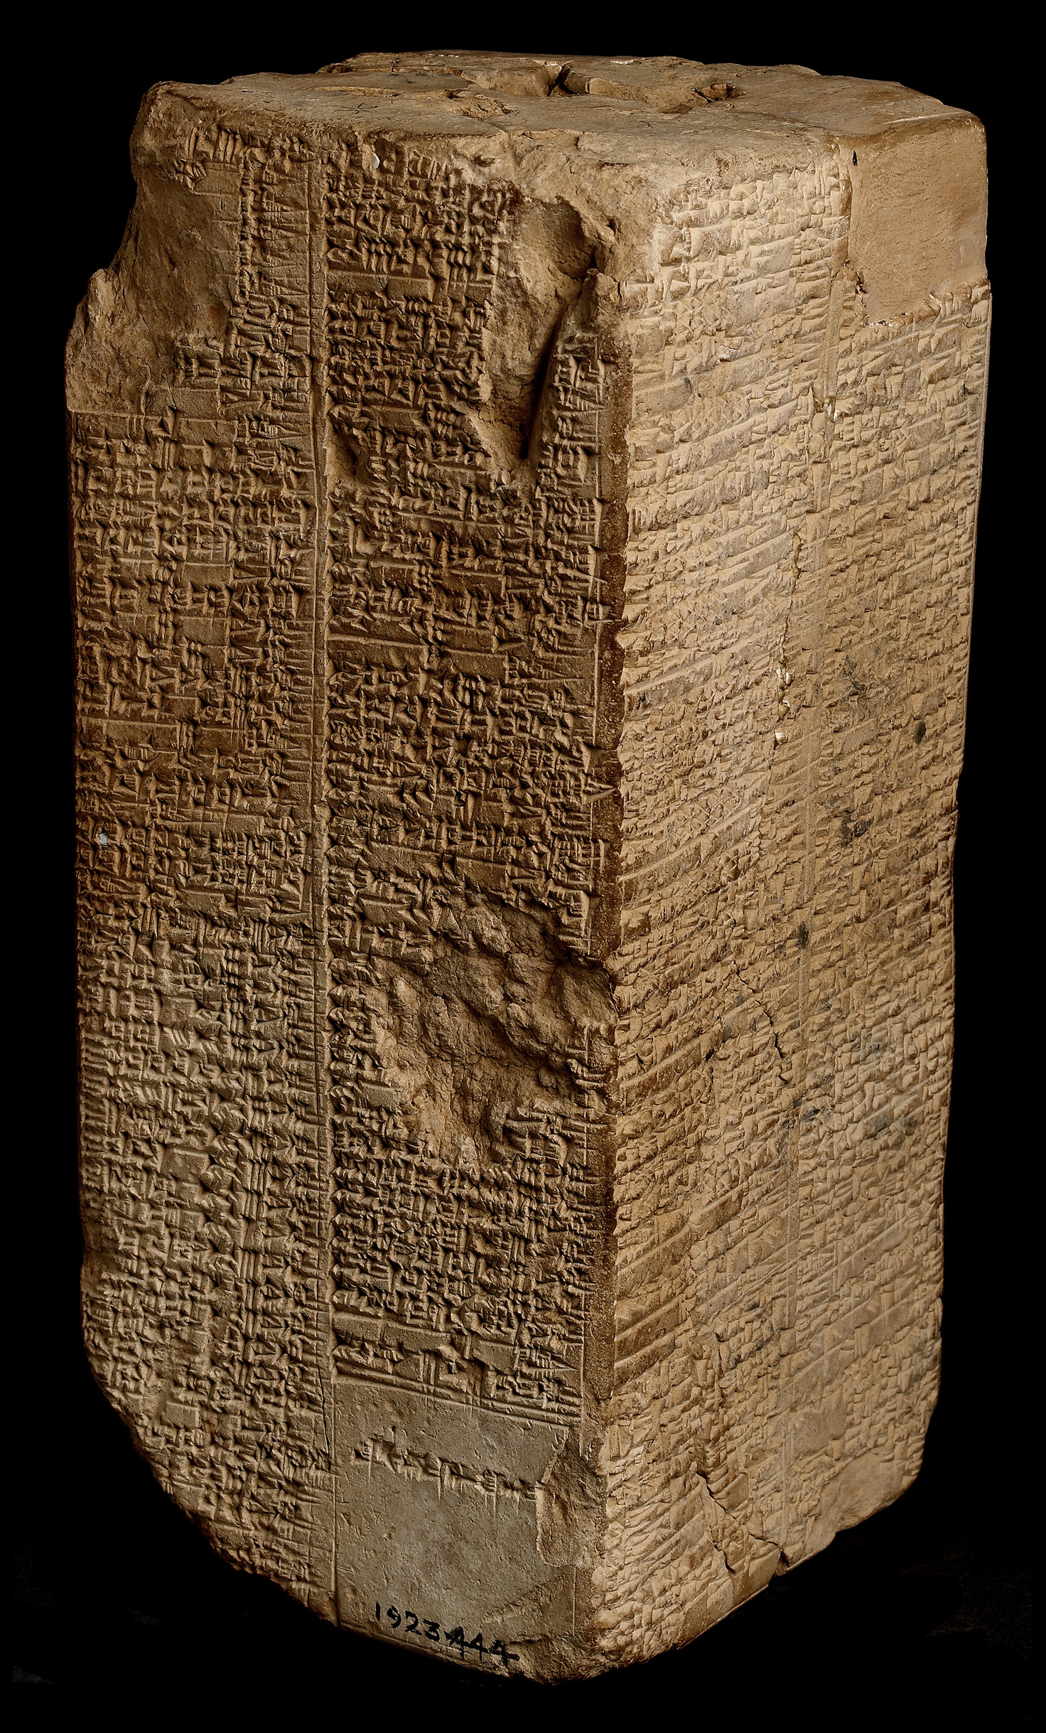
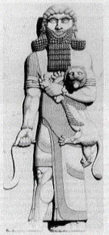
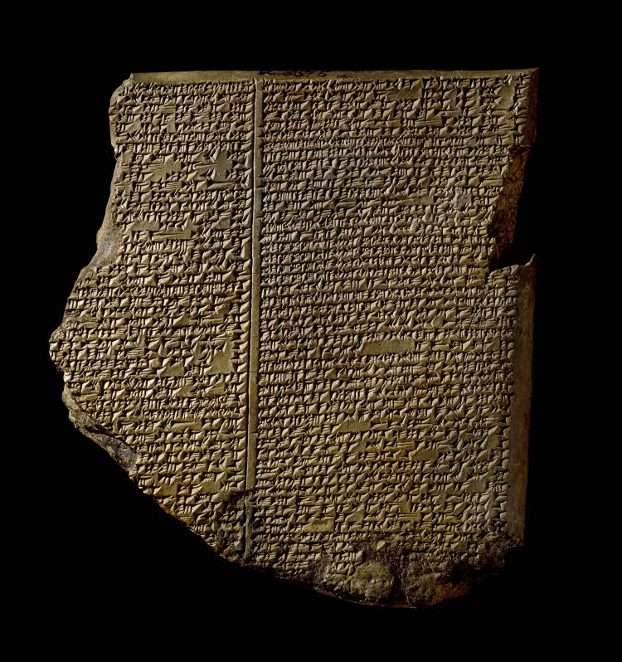
Epic of Gilgamesh
Account of king from ancient Sumerian city of Uruk circa 2700-2600 BCE
  Sumerian Kings List suggest he ruled over 120 years.
12 Clay tablets from 2100 BCE
Real event or fiction?
Line drawing of Gilgamesh statue from University of Arkansas collection http://www.clt.astate.edu/wnarey/Religious%20Studies%20Program/Religion%20Studies%20Program/Religious%20Studies%20Program%20Files/the_epic_of_gilgamesh.htm, Weld Blundell prism image: http://cdli.ox.ac.uk/wiki/doku.php?id=the_sumerian_king_list_skl, ’Flood tablet’ from Epic of Gilgamesh image: http://cdli.ox.ac.uk/wiki/doku.php?id=the_sumerian_king_list_skl,

Slide 12
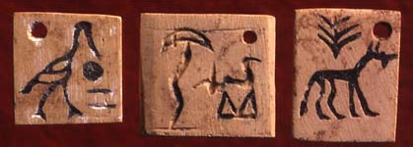
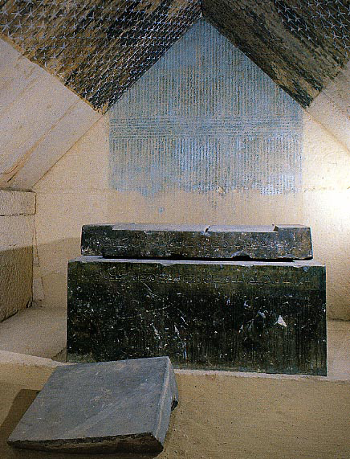
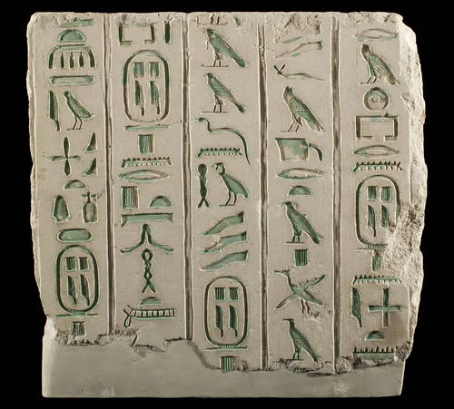
Earliest writing Egypt
Religious-Utilitarian uses?
  Accounting of things (i.e labels)
  Presence in tombs
Two versions of writing
  Hieroglyphic and Hieratic
  Different roles in sociopolitical life
  Efficiency and administration
Picture sources: H. Papazian

Slide 13
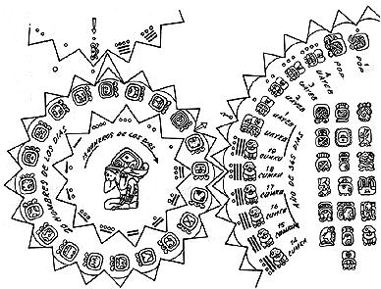
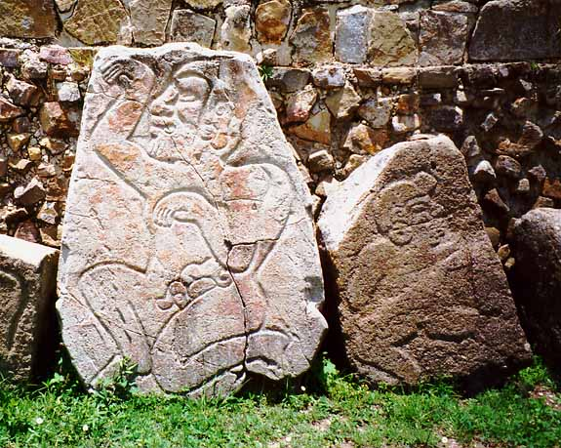
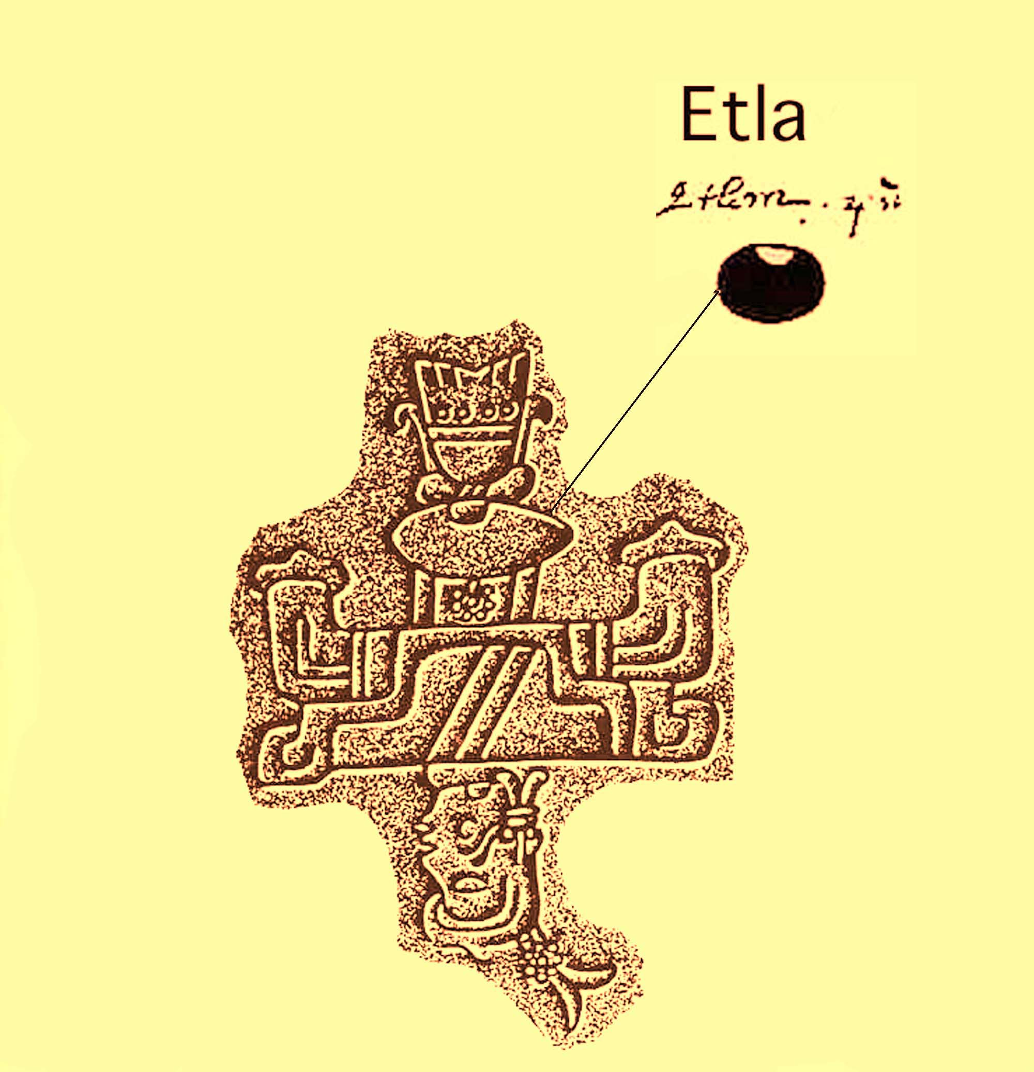
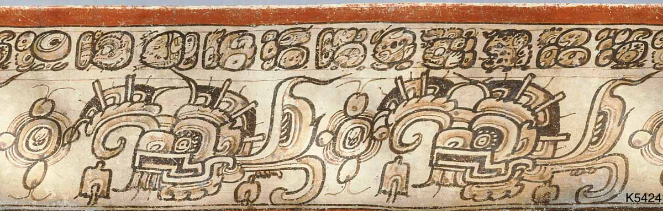
Earliest writing: Oaxaca
Calendrical Systems
  Elaborate systems for recording cycles of time
Social uses
  Legitimisation of social order
  Creation of political history

Slide 14
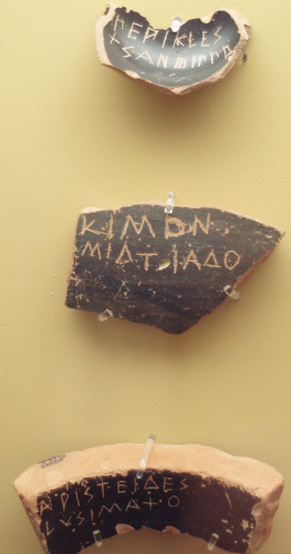
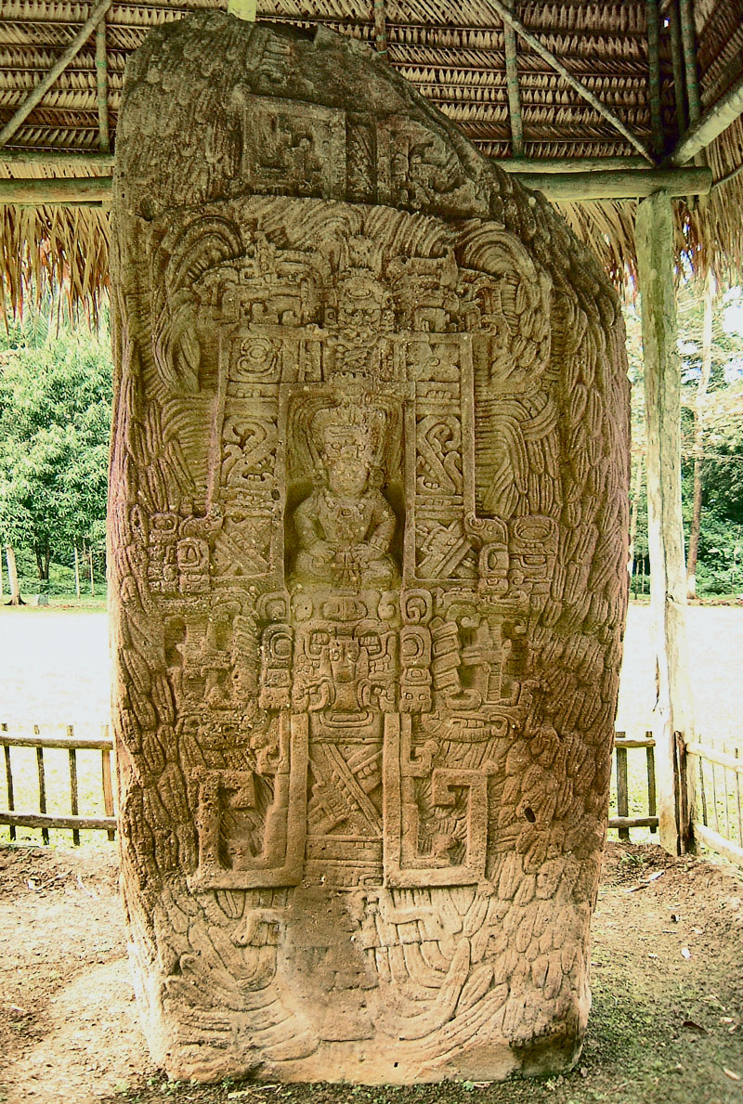
The power of writing
Creation of ‘authentic’ information/narrative
Writing as a visual social statement
  Impact on its location, spatial organisation and socio-political sanctioning
Material is often the message!
  Meanings dependent on the social context

Slide 15
Imagery and texts
Message for the masses
Links to text
Fake news?

Slide 16
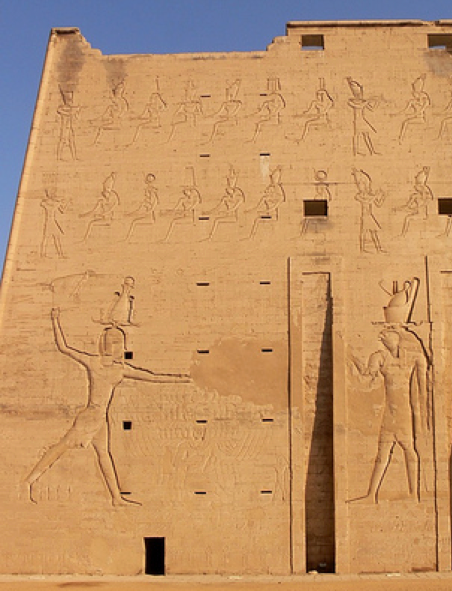
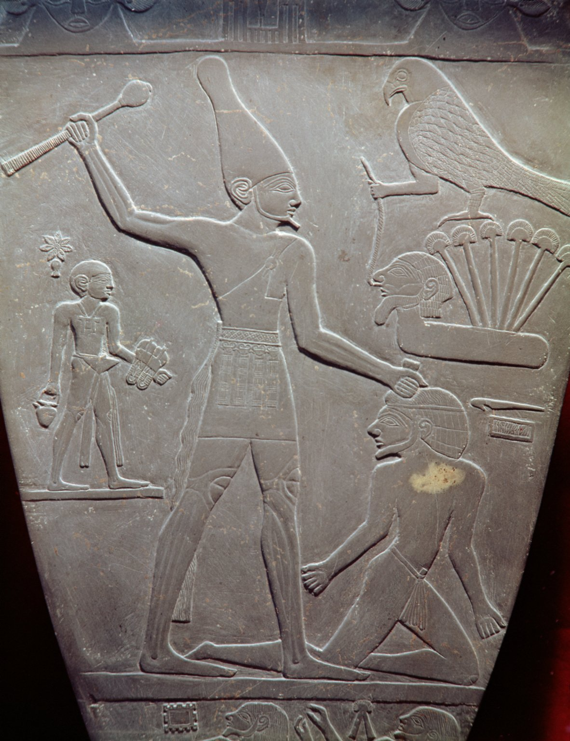
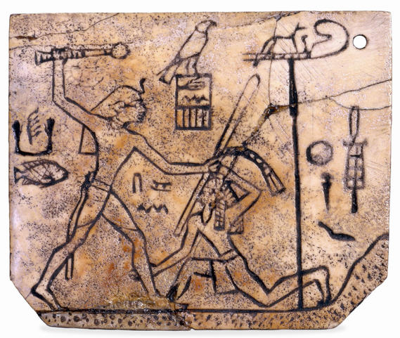
The Pharoah: Divine Defender
Narmer palette (ca. 3035 B.C.)
Edfu pylon (ca. 245 B.C.)
Ivory Label of King Den
(ca. 2900 B.C.)

Slide 17
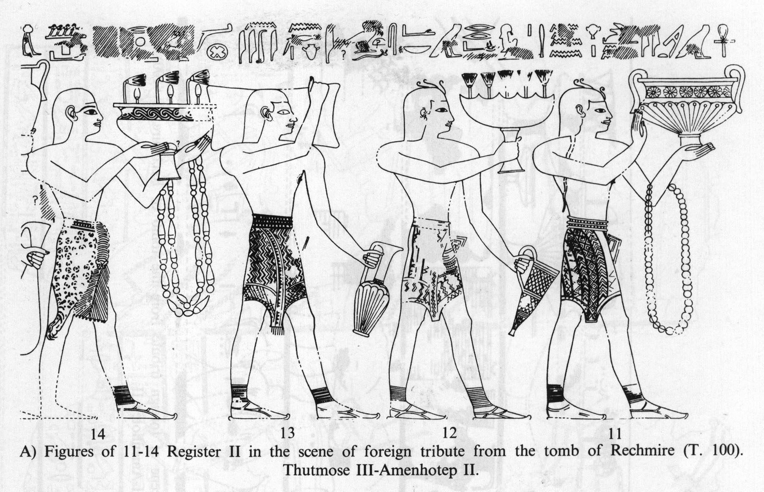
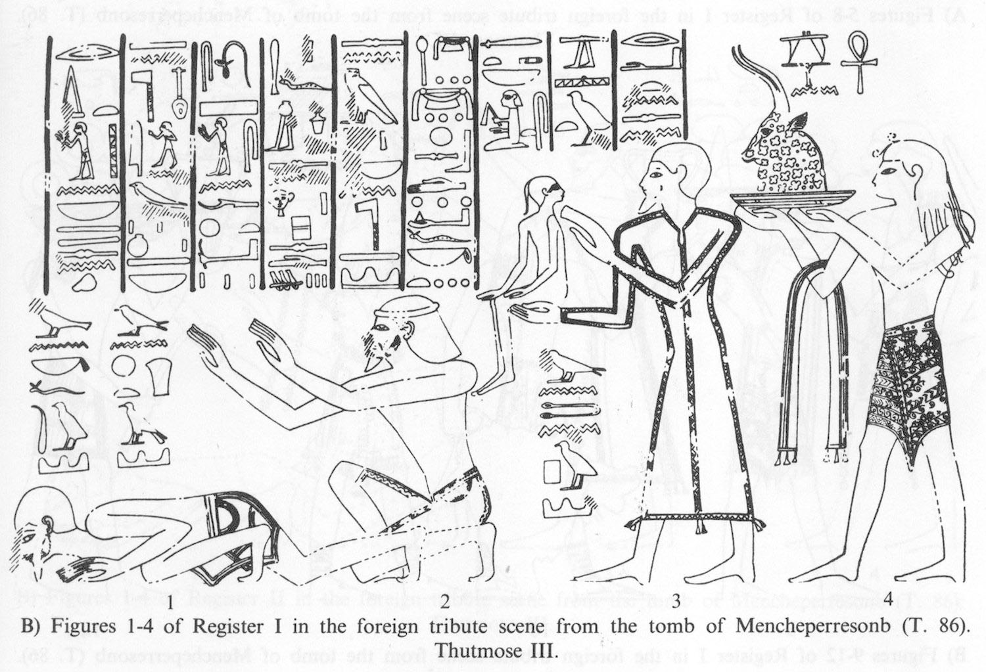
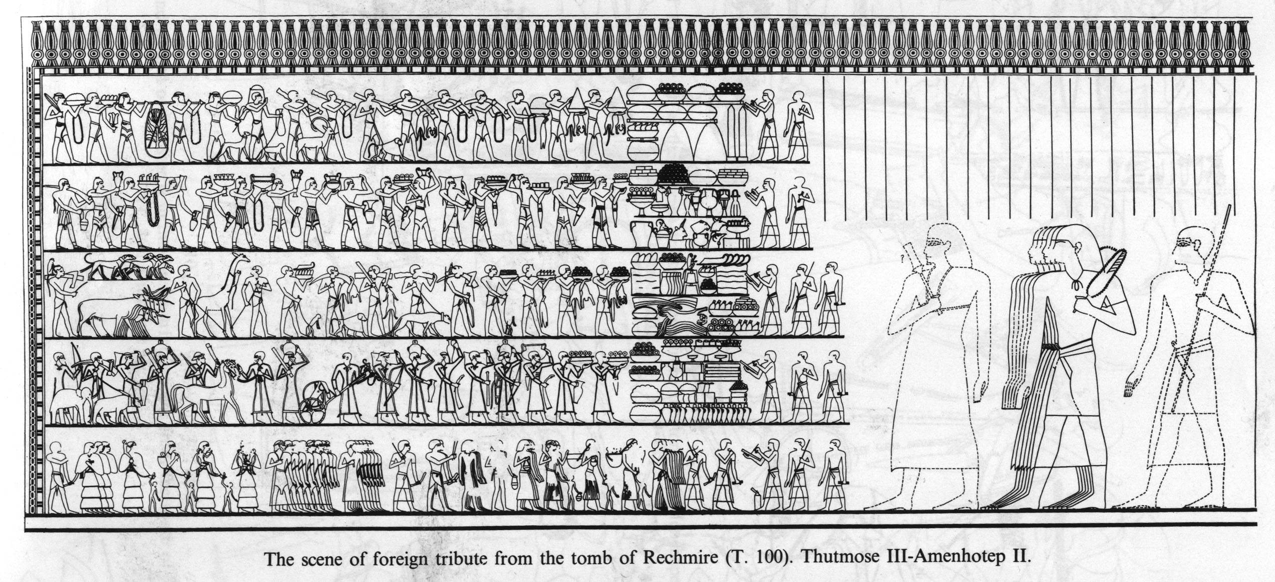
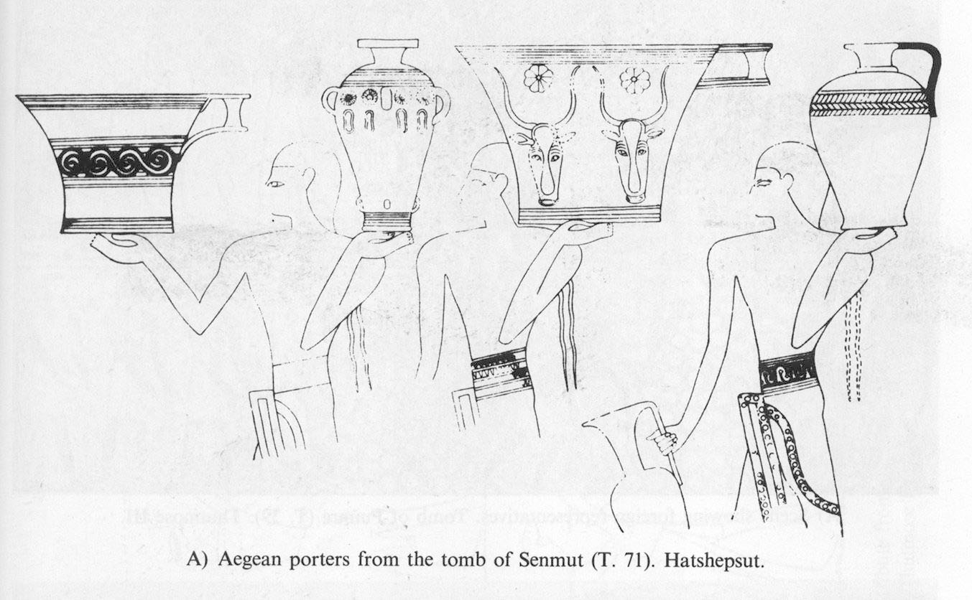
Egypt: Tribute to the State

Slide 18
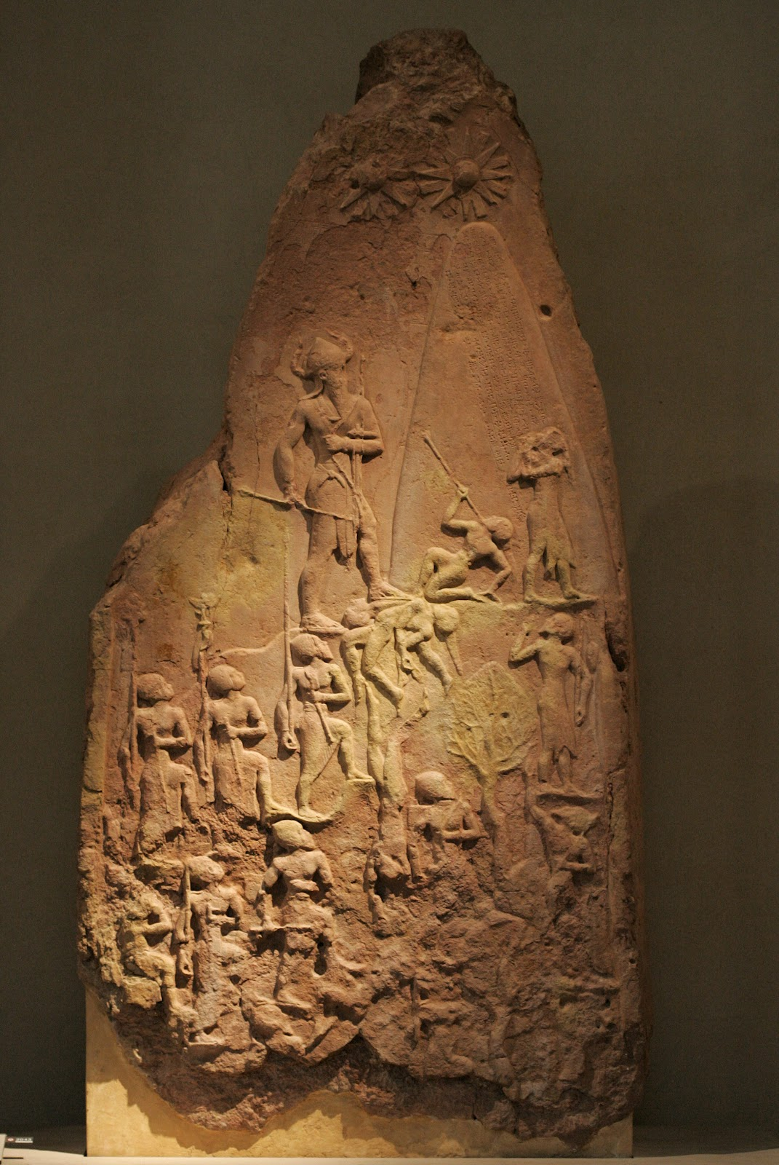
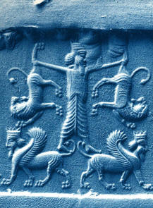
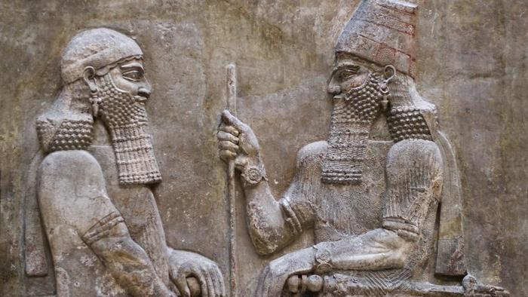
Spot the King: Ancient Mesopotamian imagery of power

Slide 19
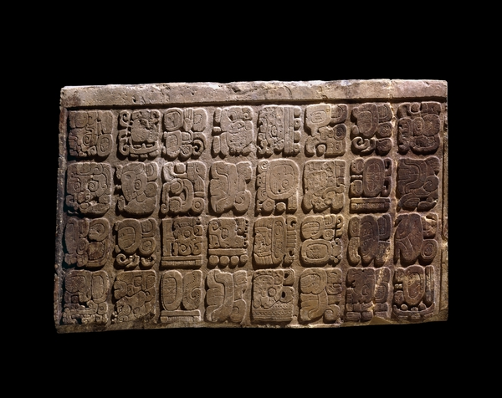
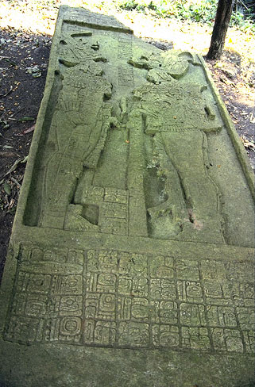
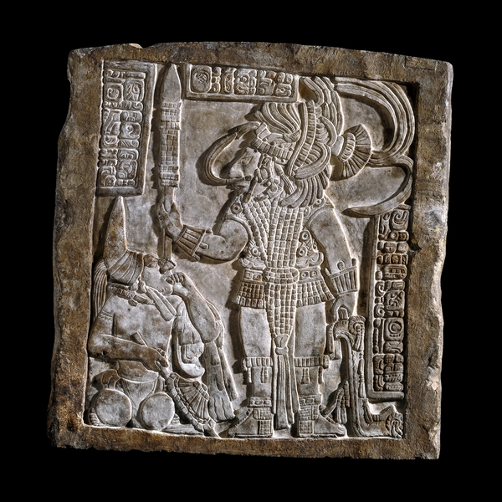
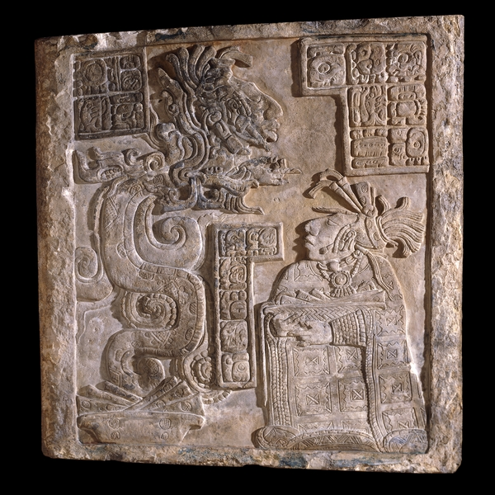
Maya Kings: Amazing life histories

Slide 20
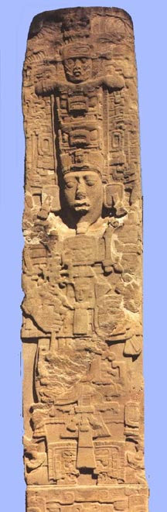




Maya Elites: Keeping the World safe

Slide 21



Copan-Quirigua: The great battle?

Slide 22




Rewriting the narrative: again….
Erased figure of
Hatshepsut

Slide 23
Is this text just getting you interested in archaeology?
The message is only part of communication – the context and material of writing helps convey meaning.
The origins of writing are diverse and use a range of different symbolic systems, but….
The origins of writing revolved around establishing economic or political authority
Communication relies on material culture to ‘materialise’ meaning and symbolic authority.
The use of text to create truth rather than reflect truth – Fake News is nothing new!

